Slide 1


Football Players Value Prediction
Burak Arslan

Slide 2
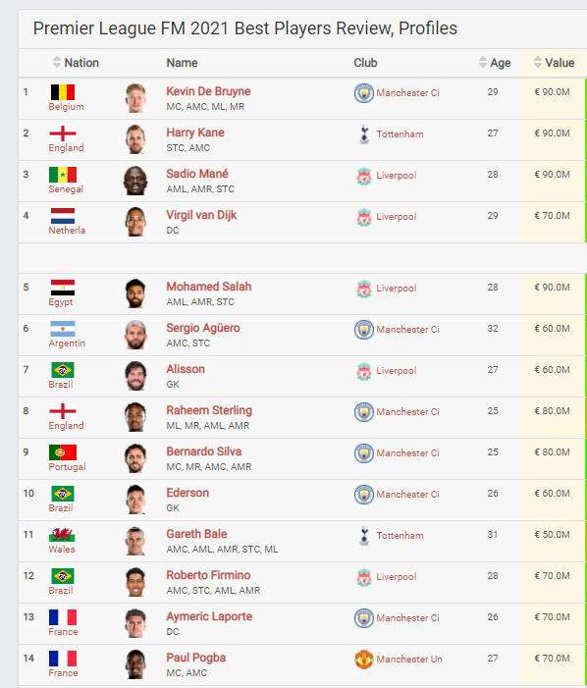
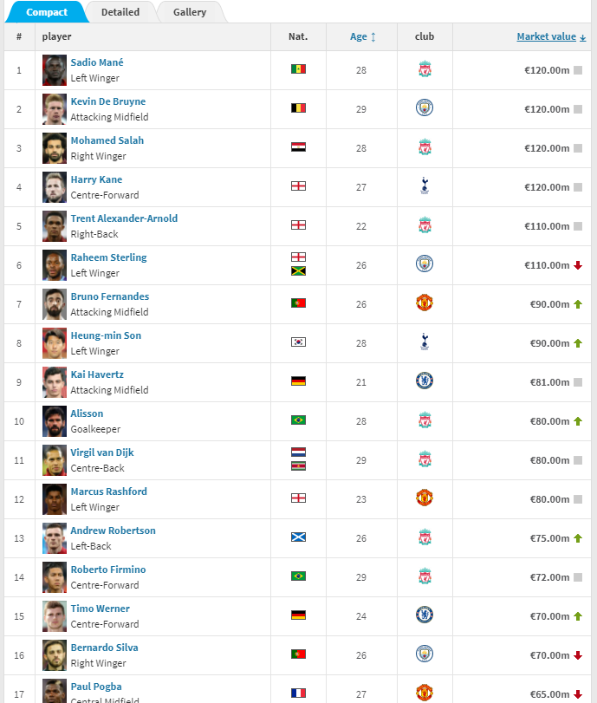
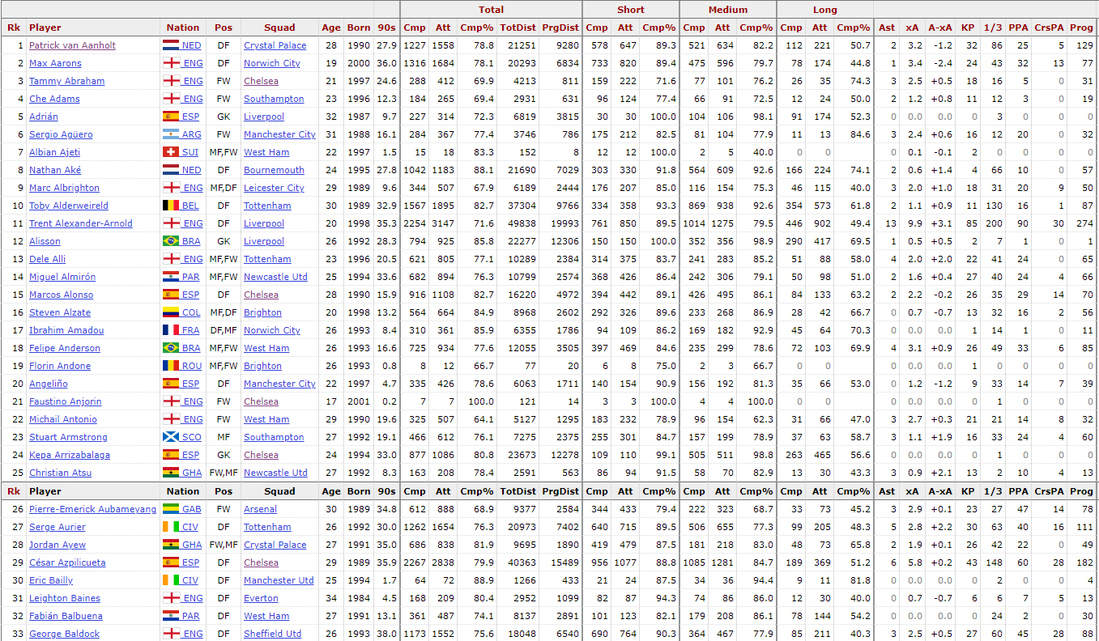
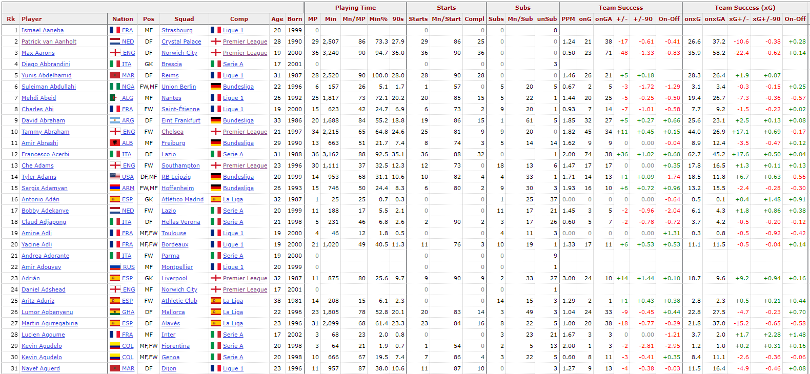
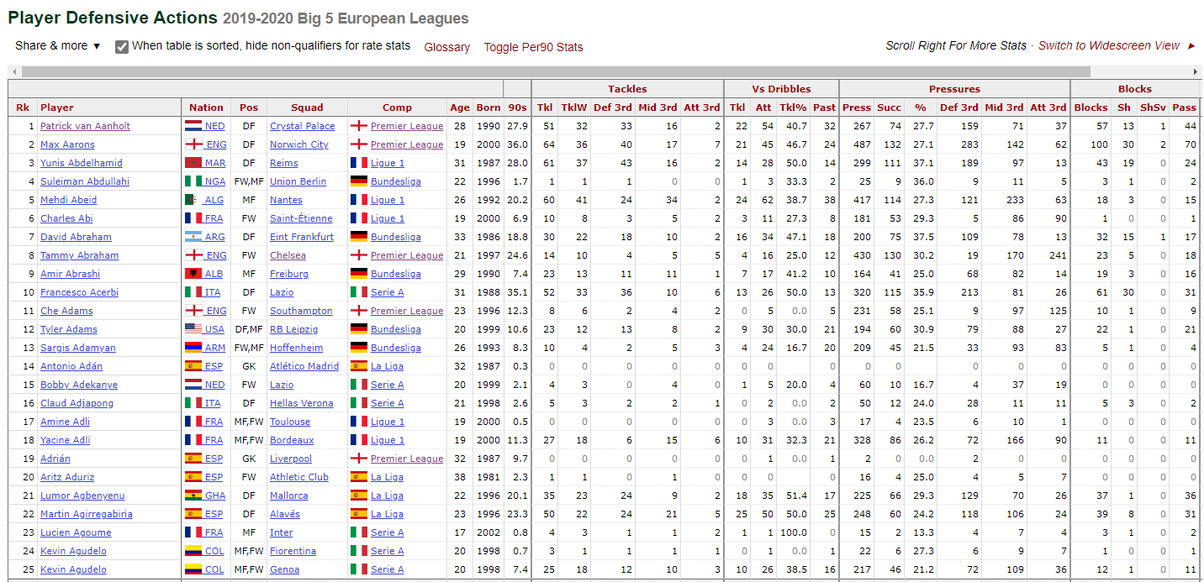
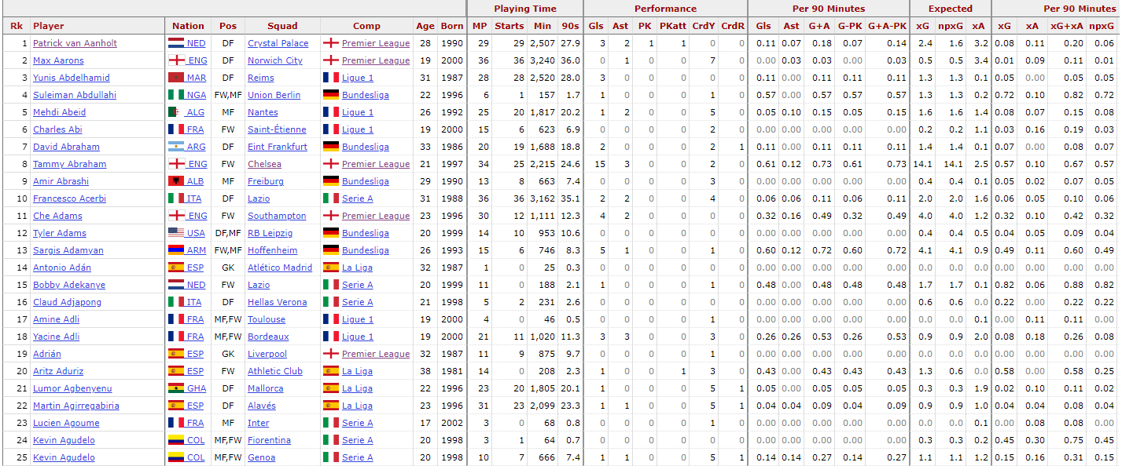
Introduction
Is it possible to determine a player’s value
by his statistics ?

Slide 3









Methodology
Data Fetch & Data process
Web Scraping
2019/2020 Season Statistics
Football Manager 2021 Game Player Values
Transfermarkt.de Player Values
Exploratory Data Analysis
Feature Tuning
OLS & Regression Models
Prediction

Slide 4
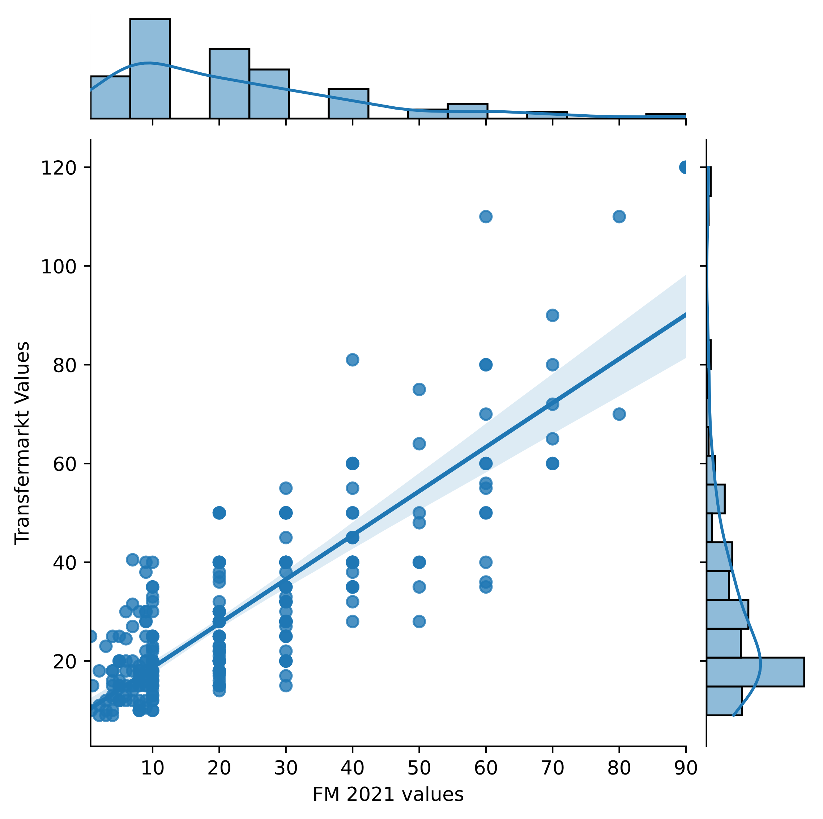
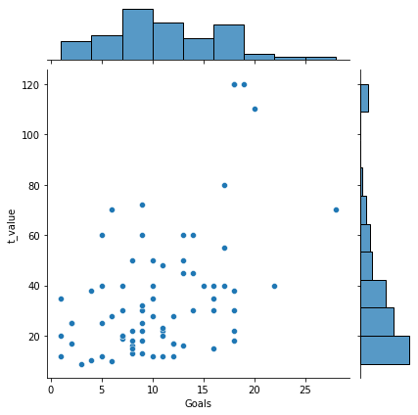
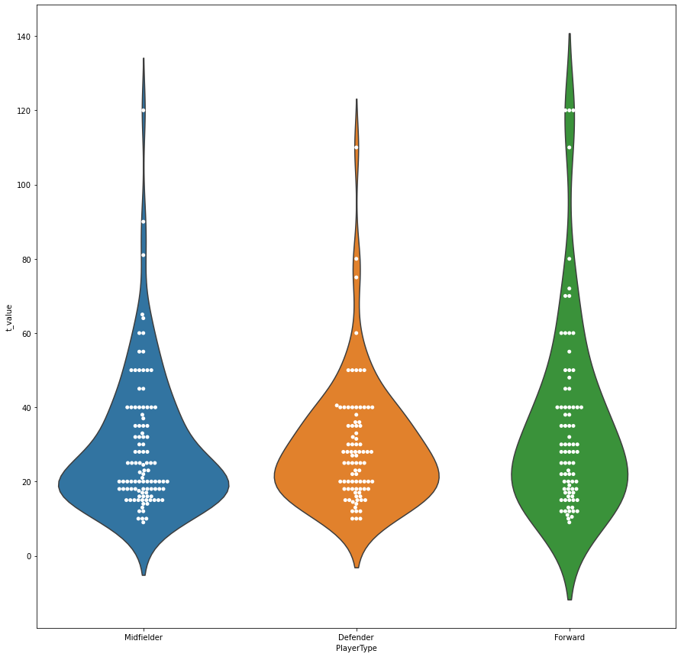
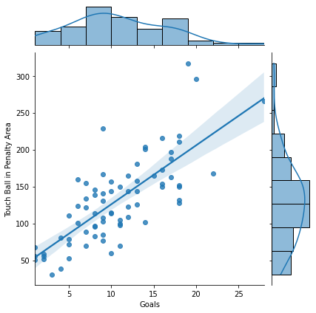
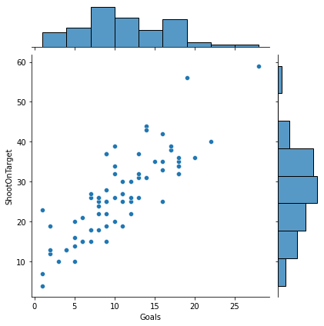
Exploratory Data Analysis

Slide 5
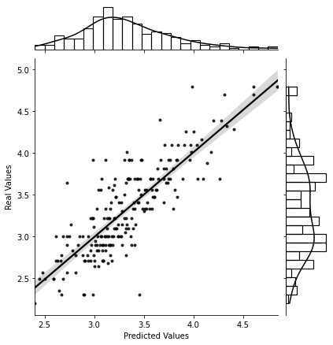
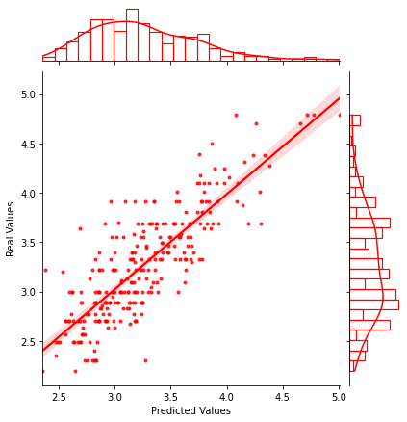
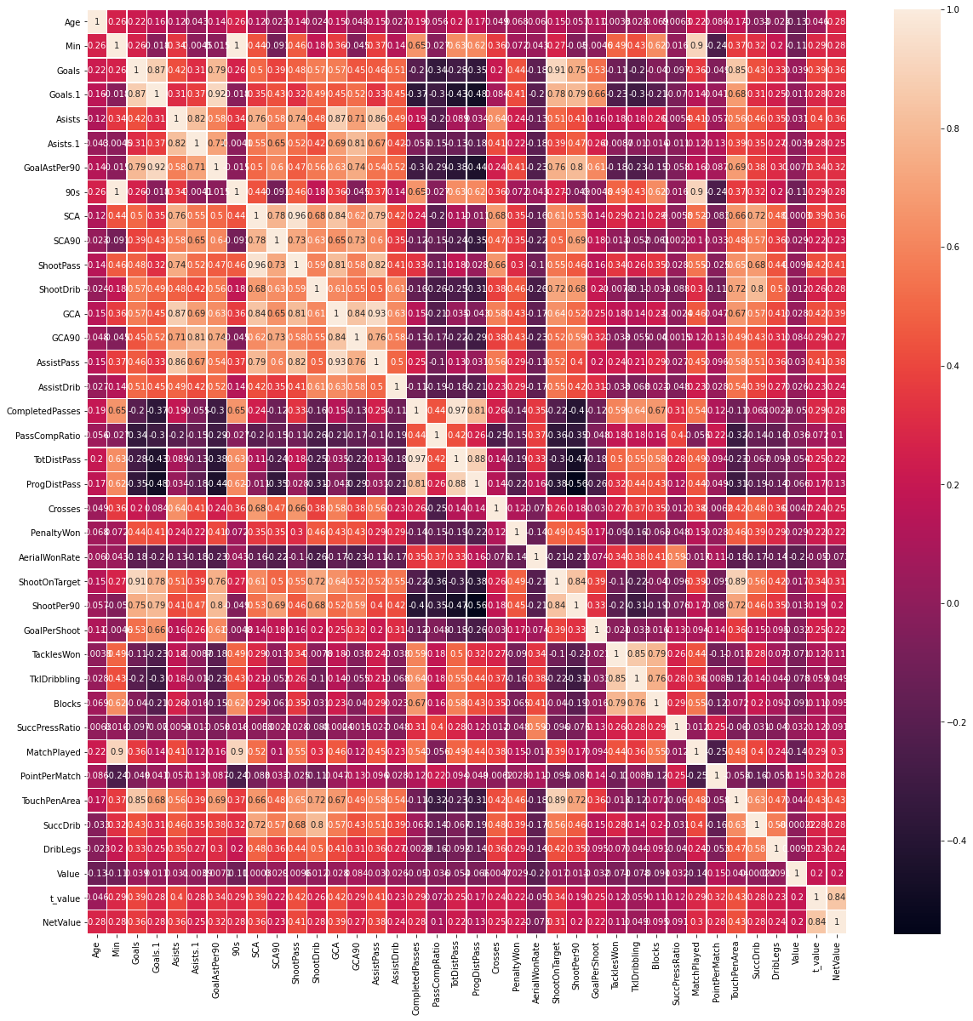
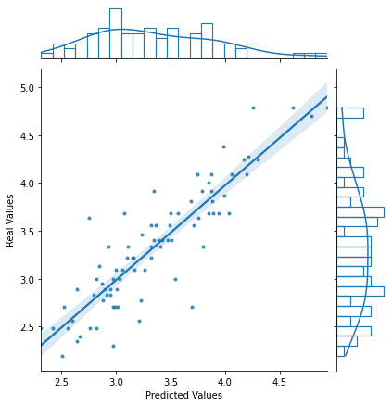
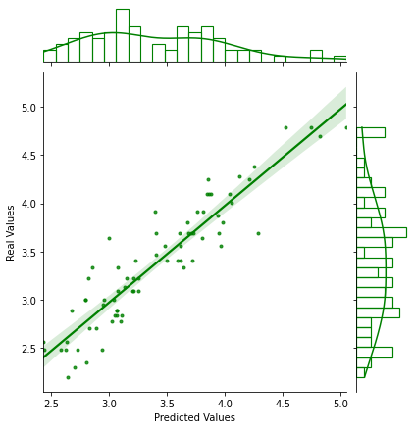
Results
All Players
Defenders
R^2 score : 0.69
R^2 score : 0.68
Midfielders
Forwards
R^2 score : 0.79
R^2 score : 0.86

Slide 6
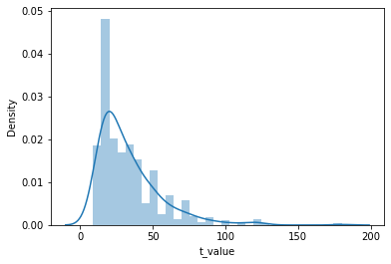
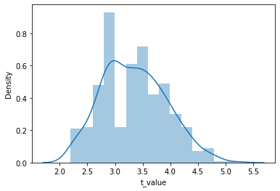
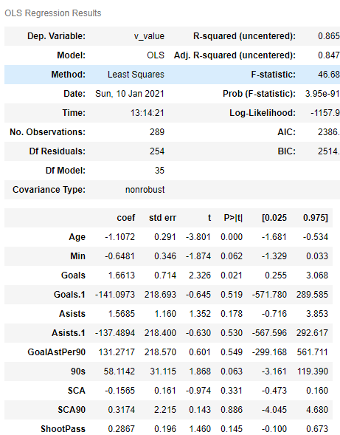
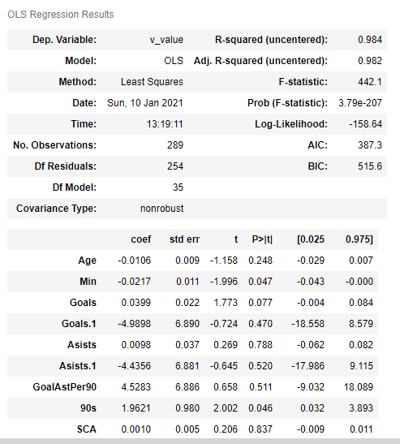
Results
Natural logarithm of Transfermarkt values
New Features for Better Fitting
1- Agegroup instead of Age
2- Winner : ( Point per Match Played ^ 2 * Played Match count )
3- Goal Change Creator instead of Assist, Shoot on Target, Dribbling lead to assist, pass lead to assist, Penalty won, Successful pressing at 3rd Area
4- Features that has high correlation between each other had beed removed.
Features that were converted to categorical variable into dummy/indicator variables :
1- League
2- Player Position
And many features had been removed to overcome overfitting !
Players that were substitute mostly, also had been removed.

Slide 7
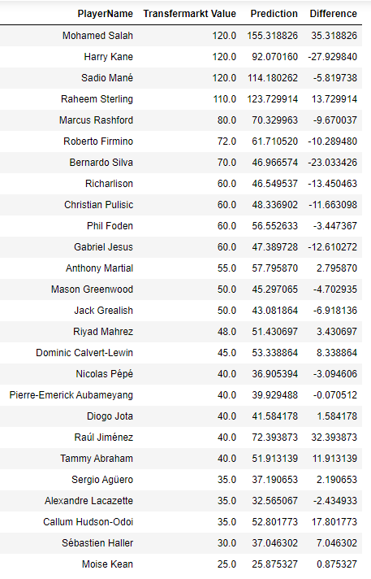
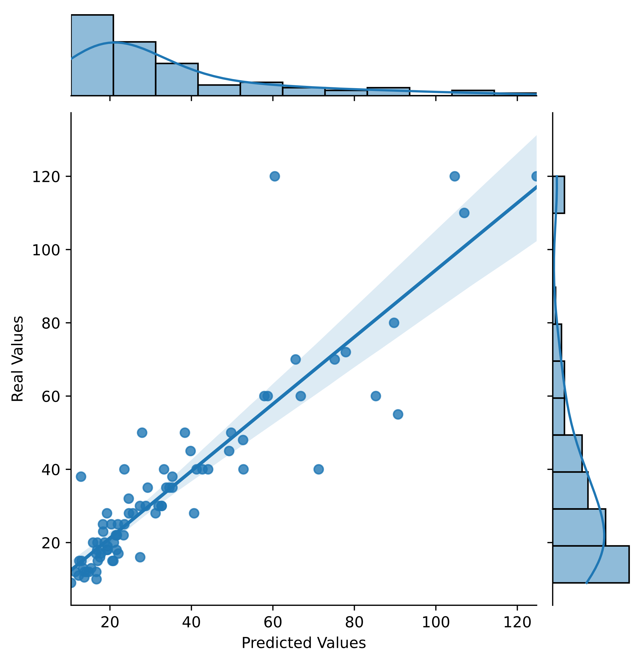
Conclusions
For more accuracy, models must build on each player type.
For more good results, we need more data, not more features.
The statistics is not a fair enough to determine players value.

Slide 8
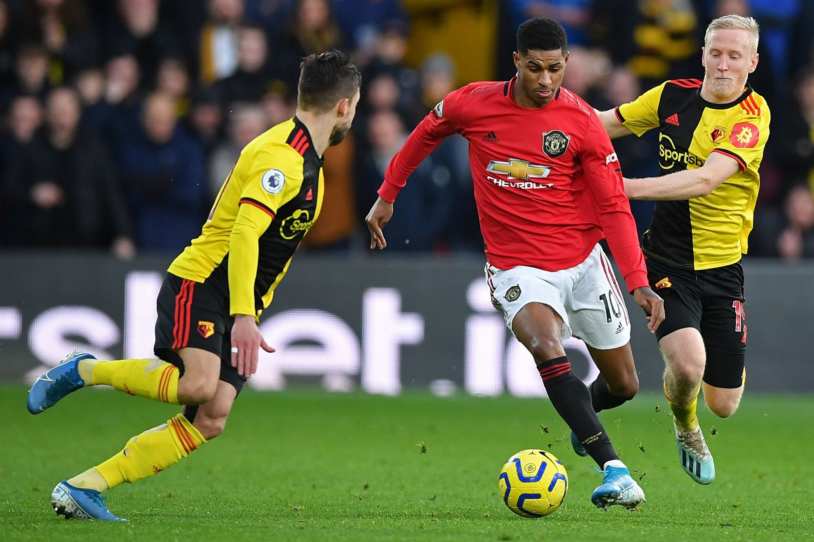
Future Work
Data Enrichment Options & Challenges :
Substitute players : Missing Stats.
Team members may affect each other’s statistics.
Prone to injury.
Last year on contract.
Player home country popularity.
Can play big matches.
Player leadership.
Work rate & ethics.
Web search popularity.
The economic strength and prestige of the club.

Slide 9

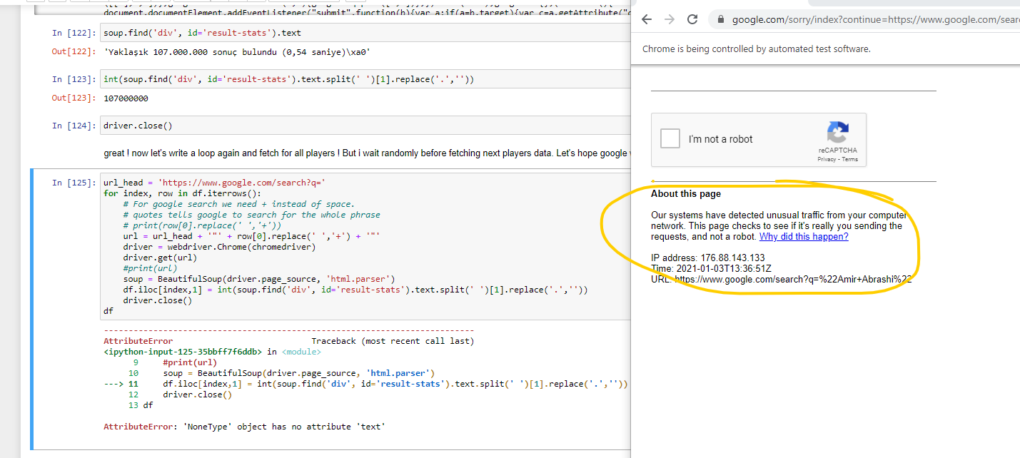
Appendix
Selenium -> Google & Bing

